Slide 1

DKSS
Dattakala Group of Institutions Faculty of Engineering
Department of Computer Engineering
Savitribai Phule Pune University
Academic Year: 2025-2026
Project Review
On
“AI Powered Resume Builder/Analyzer”
Presented By Guided By:
  Akash Ashok Phadtare(60) Prof. Dr. Bere S.S
  Abhijit Sanjay Thorat(50)
  Ganesh Motiram Jadhav(22) Co-Guided By:
  Shubham Dattatray Jadhav(62) Prof. Miss. Jagtap P.S
  Shrikant Nagnath Kadam(58)
  Project Coordinator
  ( Prof. Mrs. Dalavi M.T.)

Slide 2
AGENDA
Contents
Introduction
Rationale
Literature Review
Problem Statement
Objectives
1
2
3
4
5

Slide 3
Contents
6
Requirements Identified
Feasibility and Scope
Proposed Methodology
Risk Identified
Backup plan
7
8
9
10

Slide 4
AGENDA
Contents
11
UML Diagrams
Expected Outcome
Timeline Chart
References
Conclusion
12
13
14
15

Slide 5
AGENDA
Introduction
Resumes are the first step in the recruitment process.
Many job seekers struggle to create ATS-friendly and professional resumes.
Traditional resumes often fail to match specific job descriptions (JD).
Recruiters spend limited time scanning resumes, leading to missed opportunities.
AI and NLP can be used to analyze, score, and improve resumes automatically.
Resume Builder module helps users design resumes with predefined templates.
System provides real-time suggestions, keyword optimization, and formatting checks.

Slide 6
Rationale
Increasing competition in the job market requires smarter tools for job seekers.
Many resumes are rejected due to ATS incompatibility and poor keyword alignment.
Manual resume screening by recruiters is time-consuming and error-prone.
Lack of professional guidance results in resumes that fail to highlight relevant skills.
AI-powered systems can bridge the gap between job seekers and recruiters.
The project ensures fair, efficient, and intelligent resume evaluation.
Supports job seekers in tailoring resumes to specific job descriptions.
Enhances overall employability and shortlisting chances.

Slide 7
AGENDA
Literature Review
Sr.No. | Author(s) & Year | Title / Paper | Key Contribution | Relevance to Project
1 | Rosenberger J., 2025 | CareerBERT: Matching resumes to ESCO jobs | Proposed BERT-based embedding for semantic resume–JD matching | Basis for semantic similarity in Resume Analyzer
2 | Bevara R.V.K., 2025 | Resume2Vec: Transforming ATS | Developed Resume2Vec embeddings for better job retrieval | Supports embedding-based scoring system
3 | Thatavarthi G.S. et al., 2023 | Automated Resume Parsing: An NLP Approach | Designed NLP pipeline for resume parsing & entity extraction | Guides resume parsing module
4 | Enhanced Resume Screening using S-BERT, 2024 | TheSAI Publication | Used Sentence-BERT for resume–JD similarity | Validates semantic matching approach
5 | IOSR Journals, 2025 | Comparison of Models for Resume–JD Matching | Compared BERT with TF-IDF & traditional models | Confirms superiority of transformers

Slide 8
Problem Statement
In today’s competitive job market, applicants face significant challenges in creating resumes that are both professionally structured and compatible with Applicant Tracking Systems (ATS). Most resumes fail to highlight relevant skills, match specific job descriptions, or meet formatting standards required by recruiters. As a result, qualified candidates are often overlooked, while recruiters spend excessive time screening unsuitable resumes. There is a need for an intelligent system that can automatically analyze, score, and optimize resumes while also providing tools to build professional, ATS-friendly documents tailored to job requirements.

Slide 9
AGENDA
Objectives
To develop an AI-powered system for resume analysis and optimization.
To ensure resumes are ATS-compatible and aligned with specific job descriptions.
To implement NLP techniques for extracting skills, education, and experience from resumes.
To provide semantic matching between resumes and job descriptions using embeddings (TF-IDF/BERT).
To design a Resume Builder module with customizable templates and AI-assisted content suggestions.
To generate a scorecard highlighting strengths, weaknesses, and missing skills.
To allow users to download/export resumes in professional formats (PDF/DOCX).
To build a scalable, user-friendly, and secure web application.

Slide 10
System Requirements
I. Hardware Requirement:
II. Software Requirement:
For Development Environment:
Operating System: Windows 10/11, Linux (Ubuntu), or macOS
Programming Languages:
  Python (AI/NLP development – spaCy, NLTK, Transformers)
  JavaScript/TypeScript (Frontend + Backend)
Frameworks / Libraries:
  Frontend: React.js / Next.js, Tailwind CSS / Bootstrap
  Backend: Node.js (Express) or Django/Flask
  AI/NLP: spaCy, NLTK, scikit-learn, TensorFlow / PyTorch, Hugging Face Transformers
  Parsing Tools: PDFPlumber, docx2txt
Database: MongoDB / PostgreSQL / MySQL
Web Server: Nginx / Apache
Package Managers: npm / pip
Cloud Services (Optional): AWS / Firebase / Vercel / Heroku
Version Control: Git & GitHub/GitLab
For Development (Developer System):
Processor: Intel Core i5/i7 or AMD equivalent (2.4 GHz or higher)
RAM: Minimum 8 GB (16 GB recommended for AI/NLP tasks)
Storage: 500 GB HDD / 256 GB SSD (preferred)
Graphics: Dedicated GPU (NVIDIA GTX/RTX series) if AI models run locally
Network: Stable internet connection
For End Users (Client Devices):
Device: PC/Laptop/Smartphone with a modern browser
Processor: Dual Core or higher
RAM: 4 GB minimum
Storage: 200 MB free space (temporary file handling)
Network: Stable internet connection

Slide 11
Feasibility and Scope
Feasibility
Technical: Uses AI/NLP (spaCy, BERT, GPT), web tech (React, Node.js/Django).
Economic: Mostly open-source tools; low-cost cloud deployment.
Operational: User-friendly, real-time feedback, scalable design.
Time: Modular development; achievable within 4–6 months.
Scope
Resume Analyzer: ATS compliance check, keyword matching, scoring.
Resume Builder: AI-assisted content + customizable templates.
AI Integration: NLP for parsing, embeddings for similarity, AI suggestions.
Accessibility: Web-based, cross-platform (PC, mobile, tablet).
Scalability: Extendable to recruiter dashboards, LinkedIn import, interview prep.
Impact: Improves employability and job shortlisting chances.

Slide 12
Risk Identified
Data Privacy Risk – Sensitive resume data may be exposed if not secured.
AI Accuracy Risk – NLP models may misinterpret skills or context.
Compatibility Risk – Generated resumes may not meet all ATS standards.
Technical Risk – Server downtime, model errors, or integration failures.
User Adoption Risk – Users may prefer traditional resume formats.
Scalability Risk – Performance issues with large numbers of users.

Slide 13
Back-up
Regular database backups (MongoDB/PostgreSQL).
Cloud storage redundancy (AWS S3/Firebase).
Scheduled automated backup system (daily/weekly).
Version control using Git/GitHub for source code.
Failover servers for uninterrupted service.
User data recovery through encrypted restore points.
Periodic testing of backup & recovery process.

Slide 14
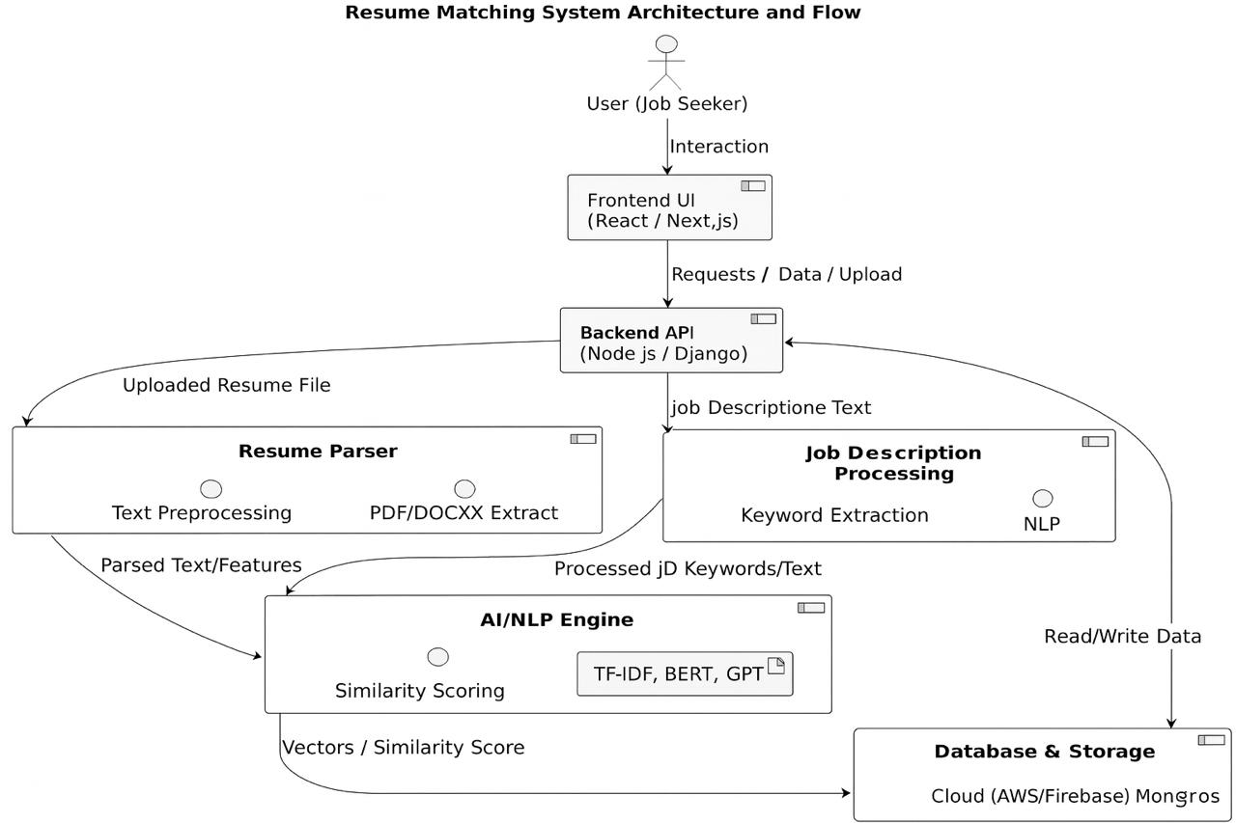
Proposed Methodology
Architecture Diagram:

Slide 15
Algorithm:
Step 1: User Interaction
User accesses the web application through a browser.
Options: Upload Resume (PDF/DOCX), Enter Job Description, or Use Resume Builder.
Step 2: Frontend (Presentation Layer)
Built with React/Next.js + Tailwind CSS.
Provides user-friendly interface for input, analysis, and resume preview.
Sends data to backend through API calls.
Step 3: Backend (Application Layer)
Implemented using Node.js / Django / Flask.
Handles requests from frontend, manages workflow, and coordinates with AI models.
Ensures authentication, validation, and secure communication.
Step 4: Resume Parser & Preprocessing
Extracts text from uploaded PDF/DOCX using parsing libraries.
Applies NLP preprocessing: tokenization, stop-word removal, lemmatization.
Identifies key sections: Personal Info, Education, Skills, Experience.
Step 5: Job Description Analysis
JD text is parsed and converted into feature vectors.
Keywords, required skills, and role-specific entities extracted.

Slide 16
Step 6: AI/NLP Engine
Converts both Resume & JD into vector representations (TF-IDF, Word2Vec, BERT).
Calculates Cosine Similarity and Keyword Match %.
Generates ATS compliance report (formatting, grammar, missing skills).
Uses GPT/LLM API for phrasing and content suggestions.
Step 7: Resume Scoring & Suggestions
Produces a scorecard: relevance score, strengths, weaknesses.
Suggests improvements: missing keywords, better summaries, formatting fixes.
Step 8: Resume Builder Module
Step-by-step form for manual resume creation.
AI suggests summaries, skills, and professional wording.
User chooses from ATS-friendly templates with live preview.
Step 9: Database & Storage
Database (MongoDB/PostgreSQL) stores user profiles, resume metadata, templates.
Cloud Storage (AWS/Firebase) stores uploaded files securely.
Step 10: Output Layer
Final resume available for export in PDF/DOCX format.
Users can save resumes and reports in their dashboard for future use.

Slide 17
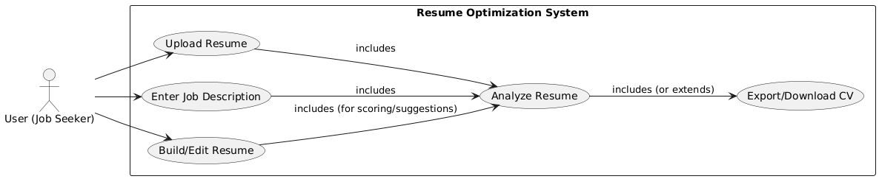
UML Diagrams
Use Case Diagram:

Slide 18
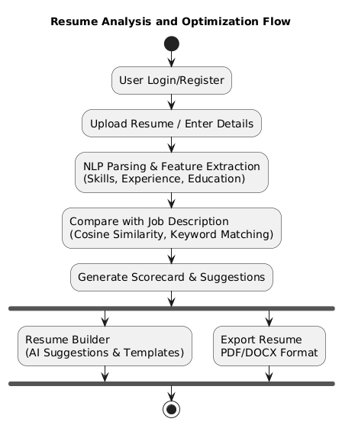
Activity Diagrams
Activity Diagram:

Slide 19
Expected Outcome
Intelligent web app for resume analysis and building.
Accurate resume parsing (skills, education, experience extraction).
ATS compliance check with scoring system.
Semantic resume–job description matching using NLP/AI.
AI-powered content suggestions for professional phrasing.
Multiple ATS-friendly templates for resume creation.
Export option in PDF/DOCX format.
Enhanced employability and shortlisting chances for users.

Slide 20
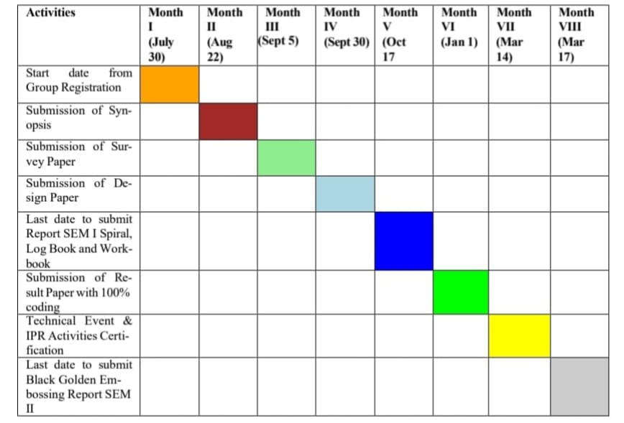
Timeline Chart

Slide 21
Conclusion
The system provides an AI-powered solution for resume analysis and building.
Ensures ATS compatibility and better alignment with job descriptions.
Reduces recruiter workload through automated screening.
Offers personalized recommendations and professional resume templates.
Enhances job seekers’ chances of shortlisting in competitive markets.
Demonstrates the effective integration of AI, NLP, and web technologies.

Slide 22
References
Rosenberger, J. (2025). CareerBERT: Matching Resumes to ESCO Jobs in a Shared Embedding Space. Elsevier, ScienceDirect.
Bevara, R.V.K. (2025). Resume2Vec: Transforming Applicant Tracking Systems. MDPI Electronics.
Thatavarthi, G.S., Sai, S.K. (2023). Automated Resume Parsing: A Natural Language Processing Approach. IEEE CSITSS Conference.
Enhanced Resume Screening for Smart Hiring Using S-BERT. The Science and Information Association (TheSAI), 2024.
IOSR Journals. (2025). Comparison of Models for Resume–Job Description Matching Using BERT.
AI Hiring with LLMs: A Context-Aware and Explainable Framework. arXiv Preprint, 2025.
IJFMR. (2024). NLP-Powered Resume Matching for Recruitment.
IJESAT. (2024). AI-Based Resume Shortlisting Using Machine Learning Approaches.
Stanford CS224n Project Report. (2023). Document Matching for Job Descriptions Using Embeddings.
TechRxiv. (2024). Analyzing Job Matching Algorithms: A Comparative Study of BERT and Lightweight Models.

Slide 23
Thank You…

